Slide 1
INTRODUCTION TO COMPUTING
Course Code: CCINCOM/L
Abstract Data Types, Stacks
Department of Computer Science
College of Computing and Information Technologies (CCIT)
National University
Joseph Marvin R. Imperial
DATA STRUCTURES AND ALGORITHMS
NU College of Computing and Information Technologies
Course Code: CCDATRCL

Slide 2
Abstraction
Abstraction is a process of hiding the implementation details from the user. Only the functionality will be provided to the user.
In Java, abstraction is achieved using abstract classes and interfaces.
Knowing how to use it is more important than how it works.
Joseph Marvin R. Imperial
DATA STRUCTURES AND ALGORITHMS
NU College of Computing and Information Technologies
Course Code: CCDATRCL

Slide 3
Abstract Data Types (ADTs)
Abstract data types are a way of classifying data structures based on how they are used and the behaviors they provide.
They do not specify how the data structure must be implemented, but simply provide a minimal expected interface and set of behaviors.
It is called “abstract” because it gives an implementation-independent view. The process of providing only the essentials and hiding the details is known as abstraction.
Joseph Marvin R. Imperial
DATA STRUCTURES AND ALGORITHMS
NU College of Computing and Information Technologies
Course Code: CCDATRCL

Slide 4
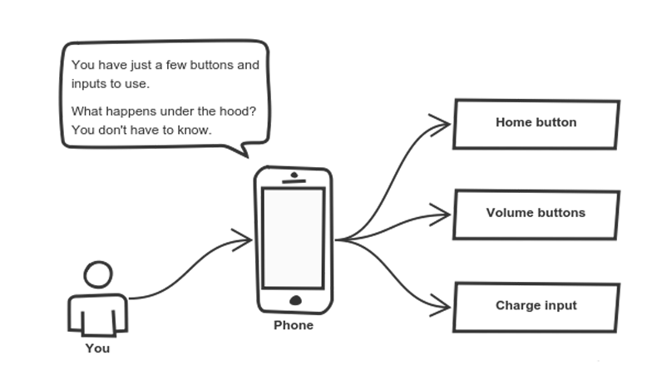
Joseph Marvin R. Imperial
DATA STRUCTURES AND ALGORITHMS
NU College of Computing and Information Technologies
Course Code: CCDATRCL

Slide 5
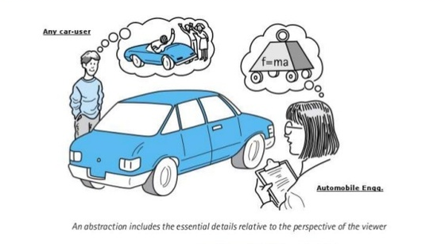
Joseph Marvin R. Imperial
DATA STRUCTURES AND ALGORITHMS
NU College of Computing and Information Technologies
Course Code: CCDATRCL

Slide 6
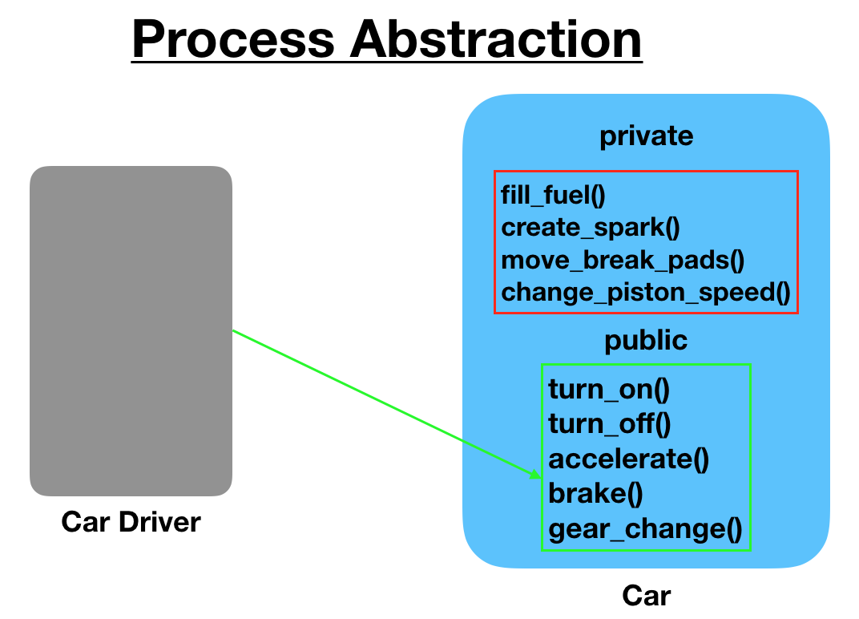
Joseph Marvin R. Imperial
DATA STRUCTURES AND ALGORITHMS
NU College of Computing and Information Technologies
Course Code: CCDATRCL

Slide 7
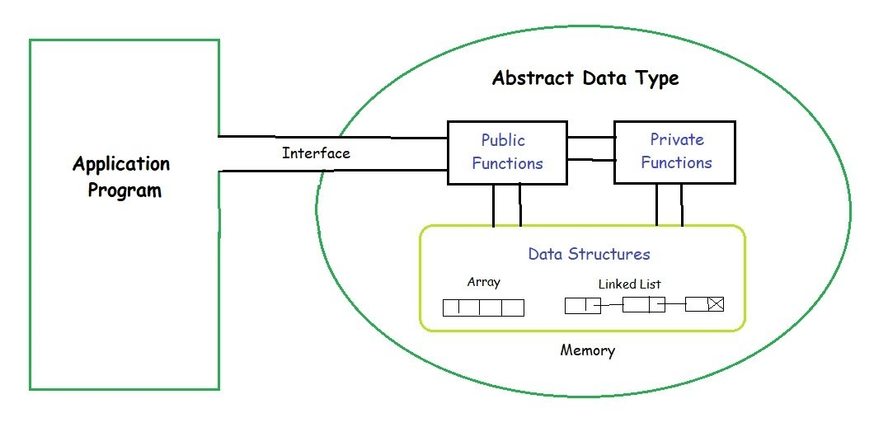
Joseph Marvin R. Imperial
DATA STRUCTURES AND ALGORITHMS
NU College of Computing and Information Technologies
Course Code: CCDATRCL

Slide 8
Abstracting data structures
Stacks, queues, and priority queues are more abstract entities than arrays, list and other data storage structures.
They’re defined primarily by their interface: the permissible operations that can be carried out on them.
The underlying mechanism used to implement them is typically not visible to their user.
Joseph Marvin R. Imperial
DATA STRUCTURES AND ALGORITHMS
NU College of Computing and Information Technologies
Course Code: CCDATRCL

Slide 9
Stacks
A stack is a linear data structure in which all the insertion (push) and deletion (pop) of data are done at one end only.
The stack has two principal operations:
push - which adds an element to the collection
pop - which removes the most recently added element that was not yet removed
The order in which elements come off a stack gives rise to its alternative name, LIFO (last in, first out).
Joseph Marvin R. Imperial
DATA STRUCTURES AND ALGORITHMS
NU College of Computing and Information Technologies
Course Code: CCDATRCL

Slide 10
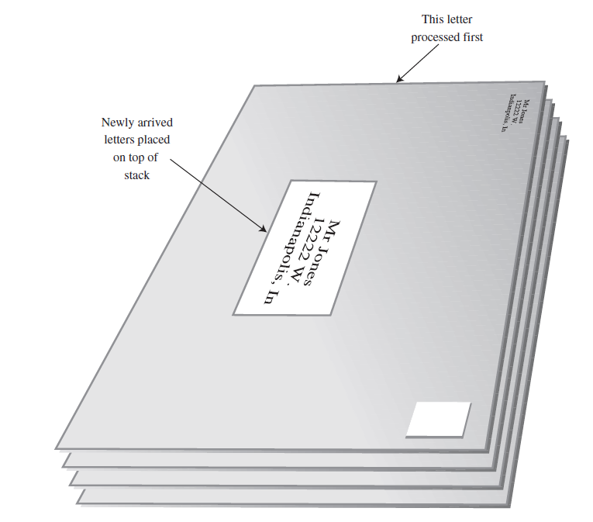
Understanding stacks: the postal analogy
Many people, when they get their mail, toss it onto a stack on the hall table or into an “in” basket at work. Then, when they have a spare moment, they process the accumulated mail from the top down.
This “do the top one first” approach works all right as long as you can easily process all the mail in a reasonable time. If you can’t, there’s the danger that letters on the bottom of the stack won’t be examined for months, and the bills they contain will become overdue.
Joseph Marvin R. Imperial
DATA STRUCTURES AND ALGORITHMS
NU College of Computing and Information Technologies
Course Code: CCDATRCL

Slide 11
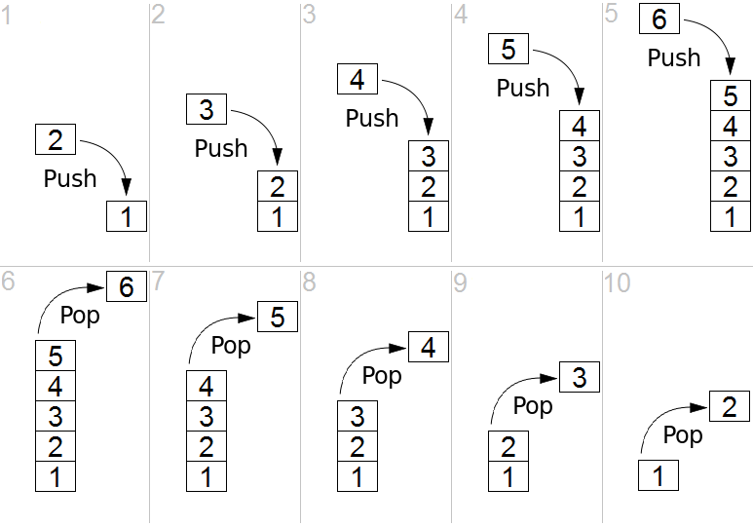
Stack
Joseph Marvin R. Imperial
DATA STRUCTURES AND ALGORITHMS
NU College of Computing and Information Technologies
Course Code: CCDATRCL

Slide 12
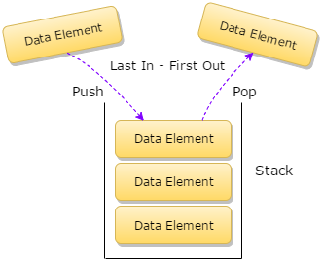
Stack
Joseph Marvin R. Imperial
DATA STRUCTURES AND ALGORITHMS
NU College of Computing and Information Technologies
Course Code: CCDATRCL

Slide 13
Stack
Joseph Marvin R. Imperial
DATA STRUCTURES AND ALGORITHMS
NU College of Computing and Information Technologies
Course Code: CCDATRCL

Slide 14
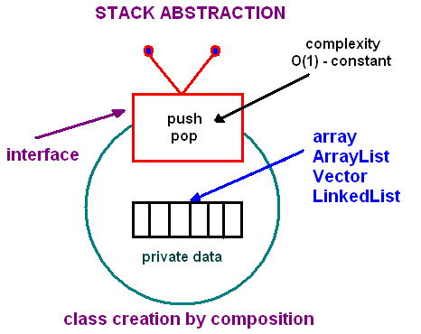
The abstraction of stack
Joseph Marvin R. Imperial
DATA STRUCTURES AND ALGORITHMS
NU College of Computing and Information Technologies
Course Code: CCDATRCL

Slide 15
Stack operations
push (new-item : item-type)
Adds an item onto the stack.
peek() : item-type
Returns the last item pushed onto the stack.
pop()
Removes the most-recently-pushed item from the stack.
isEmpty() : Boolean
True if no more items can be popped and there is no top item.
isFull() : Boolean
True if no more items can be pushed.
getSize() : Integer
Returns the number of elements on the stack.
Joseph Marvin R. Imperial
DATA STRUCTURES AND ALGORITHMS
NU College of Computing and Information Technologies
Course Code: CCDATRCL

Slide 16
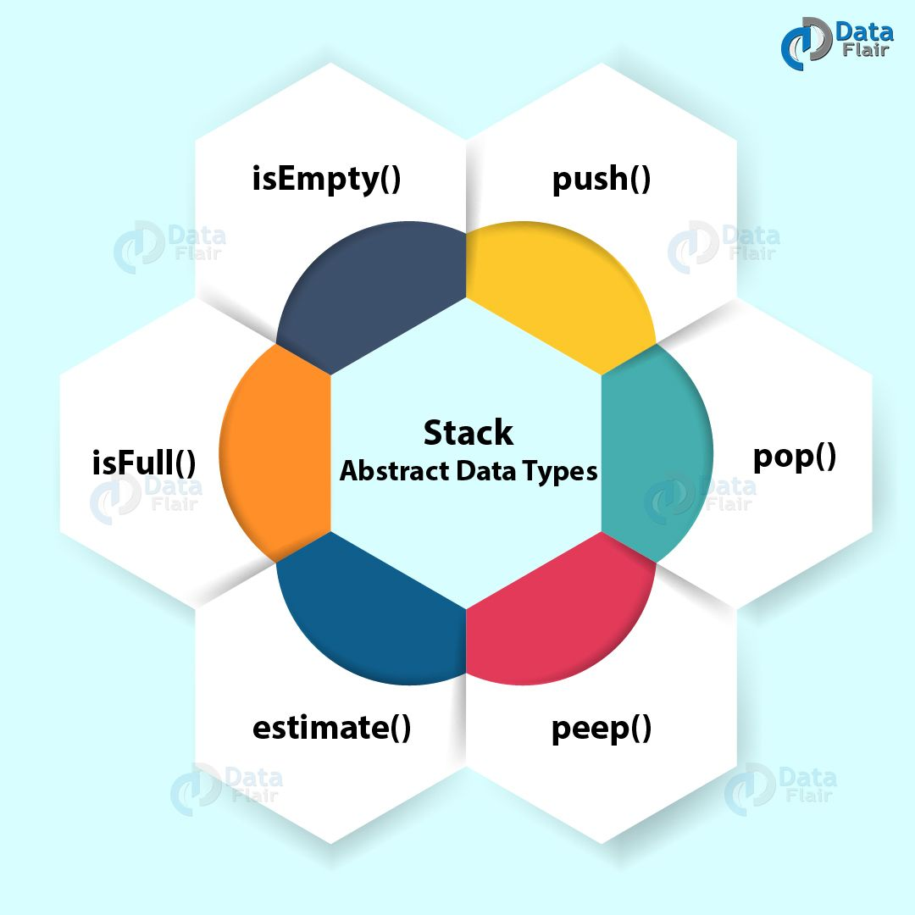
Joseph Marvin R. Imperial
DATA STRUCTURES AND ALGORITHMS
NU College of Computing and Information Technologies
Course Code: CCDATRCL

Slide 17
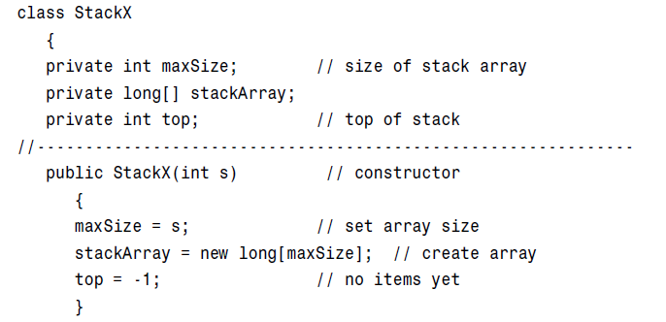
Stack implementation using arrays
Joseph Marvin R. Imperial
DATA STRUCTURES AND ALGORITHMS
NU College of Computing and Information Technologies
Course Code: CCDATRCL

Slide 18
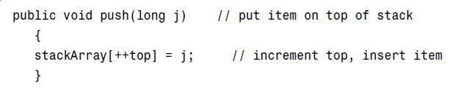
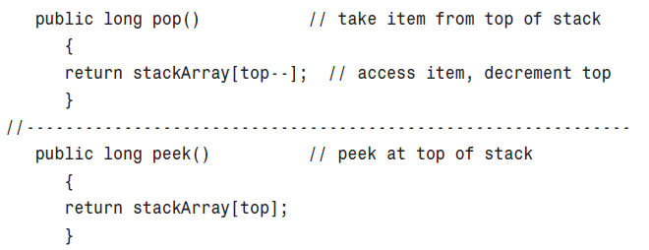
Stack implementation using arrays
Joseph Marvin R. Imperial
DATA STRUCTURES AND ALGORITHMS
NU College of Computing and Information Technologies
Course Code: CCDATRCL

Slide 19
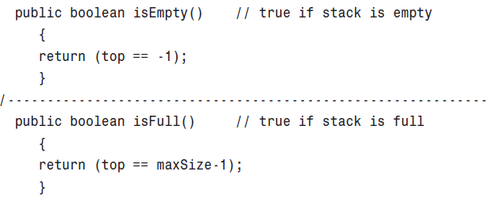
Stack implementation using arrays
Joseph Marvin R. Imperial
DATA STRUCTURES AND ALGORITHMS
NU College of Computing and Information Technologies
Course Code: CCDATRCL

Slide 20
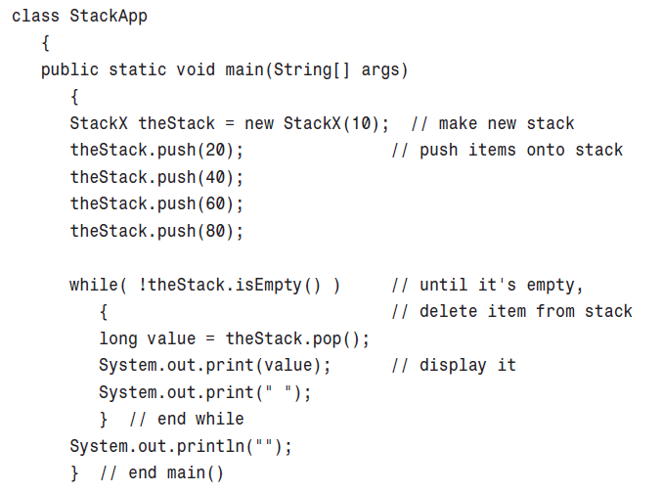
Stack implementation using arrays
Joseph Marvin R. Imperial
DATA STRUCTURES AND ALGORITHMS
NU College of Computing and Information Technologies
Course Code: CCDATRCL

Slide 21
Restricted access
The interface of these structures is designed to enforce this restricted access. Access to other items is (in theory) not allowed.
Stacks allow only one item can be read or removed at a given time (unless you cheat).
Joseph Marvin R. Imperial
DATA STRUCTURES AND ALGORITHMS
NU College of Computing and Information Technologies
Course Code: CCDATRCL

Slide 22
Error checking / handling
There are different philosophies about how to handle stack errors:
What happens if you try to push an item onto a stack that’s already full?
What happens if you try pop an item from a stack that’s empty?
It is up to you how to handle these errors logically. Many stack classes check for these errors internally, in the push() and pop() methods. This is the preferred approach. In Java, a good solution is to throw an exception, which can then be caught and processed by the class user.
Joseph Marvin R. Imperial
DATA STRUCTURES AND ALGORITHMS
NU College of Computing and Information Technologies
Course Code: CCDATRCL

Slide 23
Applications of stacks
Most microprocessors use a stack-based architecture. When a method is called, its return address and arguments are pushed onto a stack, and when it returns, they’re popped off. The stack operations are built into the microprocessor.
balancing symbols from equations
handling recursive processes
piling workloads
Joseph Marvin R. Imperial
DATA STRUCTURES AND ALGORITHMS
NU College of Computing and Information Technologies
Course Code: CCDATRCL

